Slide 1
E-Commerce Webshop
Made by: Varga Bianka
Kocsis Gábor
Nánási Zoltán

Slide 2
Functions of the program
Registration / Login
Edit own profile
Buy many things
Search/Browse on the page

Slide 3
The program
Backend - PHP – 8.1.5
Frontend – HTML/PHP
  Javascript - TypeScript
  Cascading Style Sheets (CSS)
  Bootstrap - 5.1.3
  Owl Carousel 2 – 2.3.4
Database – MySQL
  Entity Framework

Slide 4

Backend
PHP – 8.1.5

Slide 5
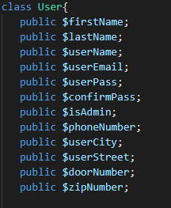
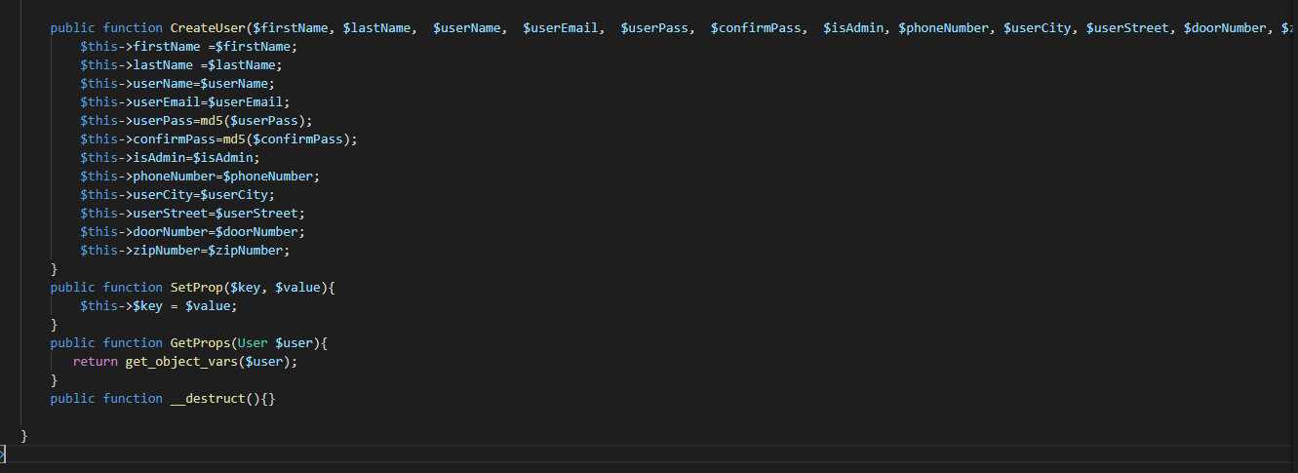
Models
Migration
Tables
Backend-frontend matches

Slide 6
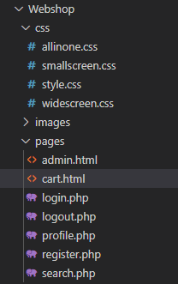
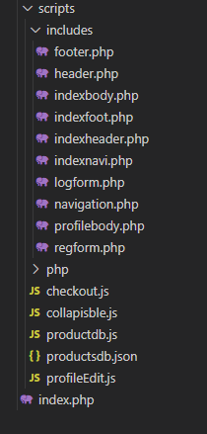





Frontend
CSS
PHP
Javascript
Bootstrap
Owl-Carousel 2

Slide 7

Database
MySQL
Model First
Entity Framework
3 tables

Slide 8
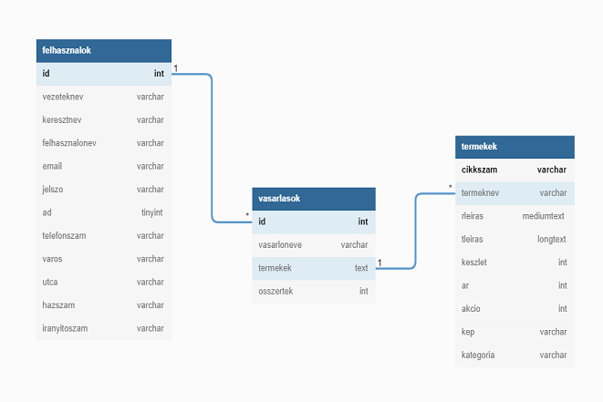
Database

Slide 9


Responsivity
Access from everywhere
Optimized for Mobile Devices

Slide 10
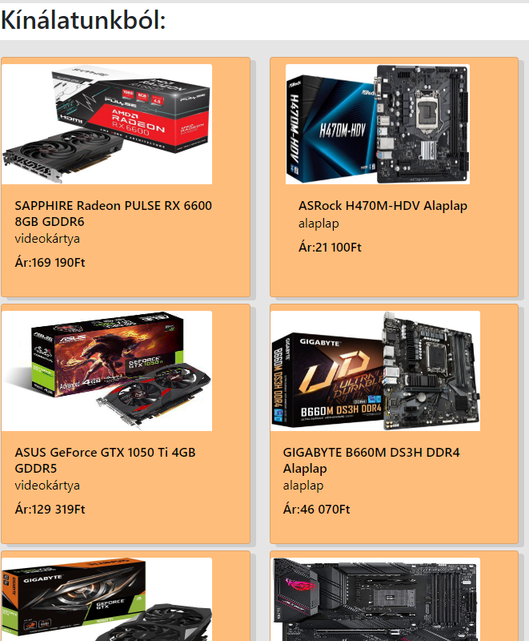
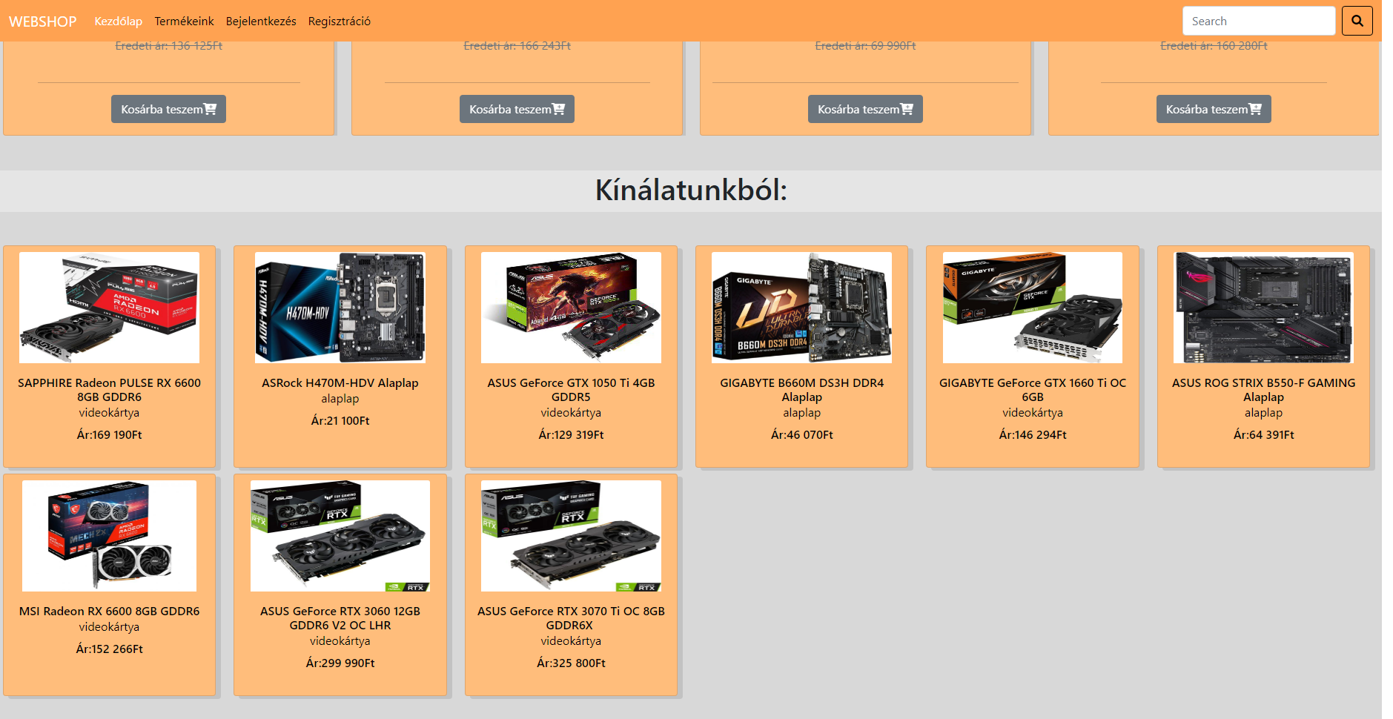
Responsivity

Slide 11
Teamwork
GitHub
Full stack seperation
Divided by tasks
Clean Code

Slide 12
Teamwork - Frontend / Backend / Database
Frontend
Nánási Zoltán
_______________
Component
  Categories
  Pages
  Carousel
  Navigation
Images
Backend
Kocsis Gábor
_______________
All of them
Database
Varga Bianka
________________
Database
  Tables
  Datas

Slide 13

Publication
GitHub Actions
Images - stored on github

Slide 14
Future (Bele kellene rakni?)
Online Payment
Advertisement

Slide 15

E-Commerce Webshop
Thanks you for your attention!

